Slide 1


Strategic Planning
Design Thinking
Your logo here!!
PERIOD: 2024/2025

Slide 2
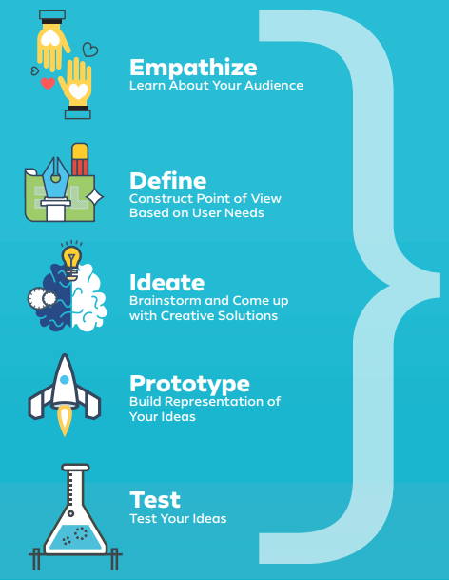

DESIGN THINKING

Slide 3




Slide 4



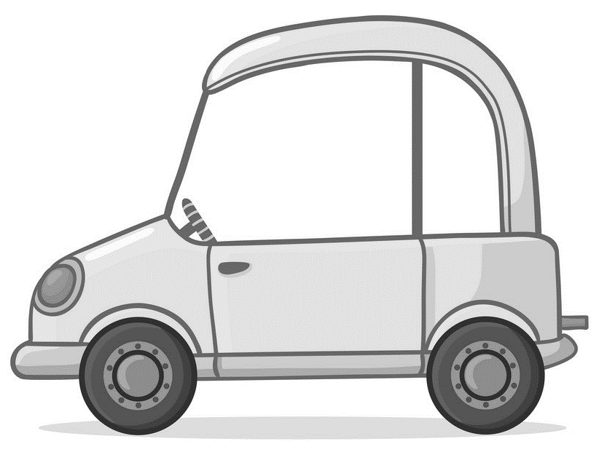
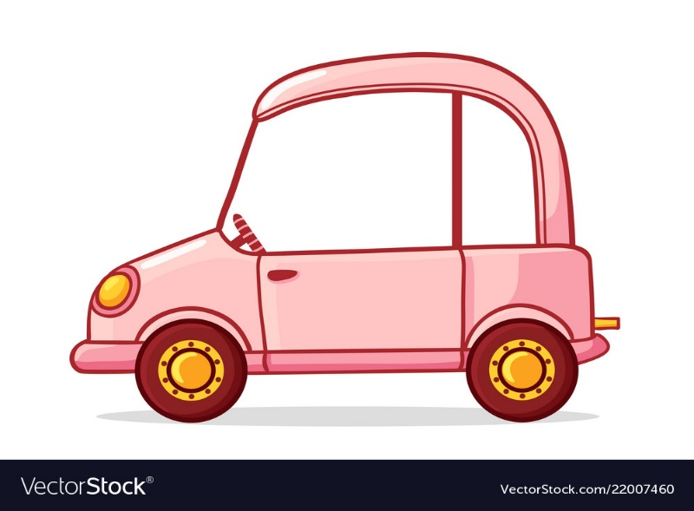
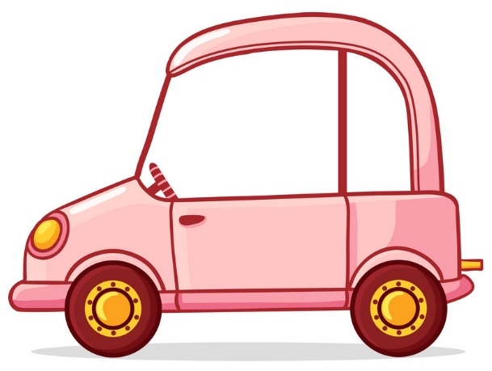
What does [Chapter Name] want from members?
What do members want from [Chapter Name]?
Others?
Paid
Member
Active
Member
Agency
Leaders
Guess
Who?

Slide 5
Leadership and succession
PUBLIC IMAGE / 30m | OFFICERS - BOARD OF DIRECTORS 90m| TALENT MANAGEMENT 30m
3 Hours:
Two 10-minute Breaks
Lunch Break
Notes:
Empathy:
Design:
Ideate:
Prototype:
Test:

Slide 6

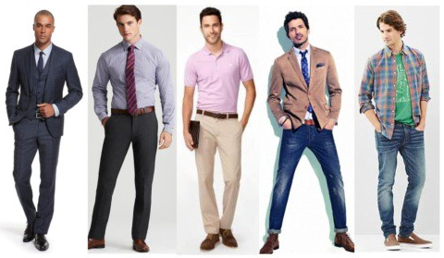
HOW Might we highlight the
[Chapter name] spokesperson from the crowd?
Are we a Business Formal, Business Casual or Casual Organization?
What public Image is Leadership seeking to Convey? Is it leading from within or presiding to create aspiration from within the members?
Is public speaking formal or informal?
No. | Define | Ideate Actions/Affirm Positions
1. | What is [Chapter’s] Public Image?
2. | Who is/are the spokesperson(s)?
Notes:
Empathy:
Define:
Ideate:
Prototype:
Test:

Slide 7

HOW Might we inspire members to ASPIRE to BOARD SERVICE?
What are the barriers to entry? What are the risks of trying?
What is the ask? What is the opportunity?
Who are we trying to recruit? Discuss emerging leaders vs experienced leaders. Are they answering the call?
What is the profile of a Chapter Leader? What are the elements that give a leader credibility?
No. | Define | Ideate Actions/Affirm Positions
1. | Does the Board Eligibility criteria require reform?
2. | Does the Board structure require reform?
3. | Does the Election/Nomination process require reform?
Notes:
Empathy:
Define:
Ideate:
Prototype:
Test:

Slide 8

HOW Might we establish a talent pipeline ?
What resources do we have?
Are we developing talent, retaining talent and recruiting talent? All?
What does the ask look like?
What does on-boarding and off-boarding look like?
No. | Define | Ideate
1. | How do we engage talent?
2 | How do we get them excited to showcase their talents?
Notes:
Empathy:
Define:
Ideate:
Prototype:
Test:

Slide 9
resilience
THE FLORIDA ELEMENT 25m | CUSTOMER CONTENT (MEMBER/VENDOR) 25m | SUSTAINABILITY 25m
75 Minutes:
One 10-minute Break
Notes:
Empathy:
Design:
Ideate:
Prototype:
Test:

Slide 10
HOW Might we distinguish
our association from others?
Game Changers
Been There Done That but Could do Better…
No Brainers
Parking Lot

Slide 11
HOW Might we program to
Maximize Member and vendor engagement?
Game Changers
Been There Done That but Could do Better…
No Brainers
Parking Lot

Slide 12
HOW Might we Sustain
our association Financially?
Game Changers
Been There Done That but Could do Better…
No Brainers
Parking Lot

Slide 13
innovation
TRADITIONS 20m | PROGRAM INVENTORY 20m | TRENDS AND OPPORTUNITIES 20m
60 Minutes:
One 10-minute Break
Notes:
Empathy:
Design:
Ideate:
Prototype:
Test:

Slide 14
Traditions that define us
Program/Action | What is good about it? | What is not good? | Can it be improved? Does it need to be preserved?

Slide 15

Programs requiring time/resources
Program/Action | What is good about it? | What is not good? | What is the ROI? Can it be improved? Does it need to be preserved?

Slide 16

Trends and
Opportunities
How might we…
___________________________________to
___________________________________to
___________________________________?
ACTION you want to achieve (e.g. verb), SUBJECT to be influenced or affected, so that… WHAT you would like to ideally achieve (outcome)?

Slide 17

Trends and
Opportunities
Sample:
How might we diversify programs to attract more members?
How might we ensure that membership programs focus on social interaction for members?
How might we better encourage seasoned professionals to mentor new talent?
ACTION you want to achieve (e.g. verb), SUBJECT to be influenced or affected, so that… WHAT you would like to ideally achieve (outcome)?

Slide 18
Trends and
Opportunities
How might we…
ACTION you want to achieve (e.g. verb), SUBJECT to be influenced or affected, so that… WHAT you would like to ideally achieve (outcome)?

Slide 19
Complete Post-Work
(Feedback Matrix)

Slide 20
Strategic plan actions
Strategic Plan
Board Recommendations
NO. | OBJECTIVE | INITIATIVE(s) | PRIORITY (High/Mod./Low) | CHAMPION (Prototype/Test) | 2024 | 2025 | 2026
1 | Succession & Leadership
2 | Resilience
3 | Innovation

